Slide 1

Chatbot Gamma
D7046E
Dpt. of Computer Science, Electrical and Space Engineering
Louise Zalamans
Alexander Mennborg
Amos Johnson
Anton Sundström
Axel Björklund

Slide 2
Introduction
Task - Chatbot
Transfer learning with pre-trained model
Amazon review dataset
Notes:
Train/Validation/Test = 80/10/10

Slide 3
The pre-trained baseline models
Developed by Google
Transformers
Huge Models trained on BOOKCORPUS(Zhu et al., 2015) and English Wikipedia (Devlin et al., 2019), These two corpora consist of around 16GB of uncompressed text.
 | BERT (large) | ALBERT (xxlarge-v2)
Parameters | 334M | 235M
Layers | 24 | 12
Hidden layers | 1024 | 4096
Embeddings | 1024 | 128
Parameter sharing? | No | Yes
Notes:
Transformers
Encode/Decode parts (RNNs?)
Both has a feed forward and self attention layer
Uses self attention:a layer that helps the encoder or decoder look at other words in the input sentence as it encodes a specific word
Decoder has another attention layer that helps the decoder focus on relevant parts of the input sentence (our attention mask?)

Slide 4
Preprocess
Split data into train/validation/test
Tokenizer
Padding
Attention mask
Notes:
Tokenizer
Vocabulary size 30 000
Removes capital letters
Numbers, symbols preserved
Adds CLS and SEP

Slide 5
Implementation - huggingface/🤗transformers
Top 10 Python libraries of 2019
Repository brings state-of-the-art NLP models to everyone.
Adds new models as they are developed (ALBERT 26 Nov 2019)
pretrained_weights = 'albert-xxlarge-v2' # Get pre-trained weights from Albert, specify what version.
#pretrained_weights ='bert-large-uncased' #swap 'Albert' to 'Bert' below
# Model class and tokenizer
tokenizer = AlbertTokenizer.from_pretrained(pretrained_weights)
model_class = AlbertForSequenceClassification
model = model_class.from_pretrained(pretrained_weights)
SequenceClassification combines transformer Model with a classification layer
Notes:
Very easy to implement

Slide 6
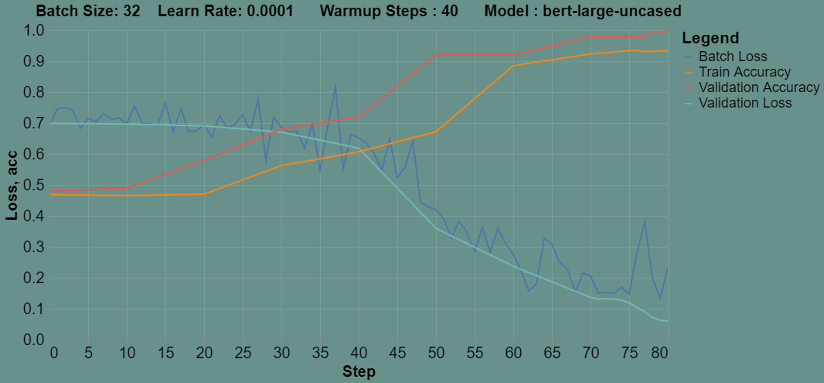
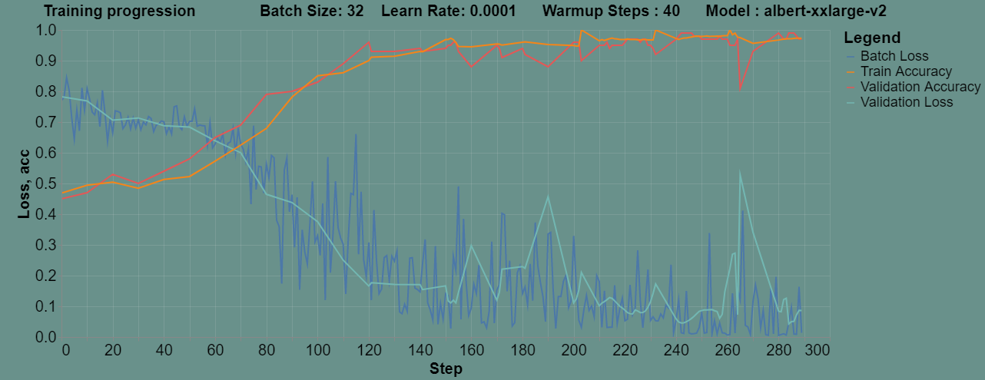
Testing predefined classifiers
BERT:
Training on: Tesla P100-PCIE-16GB
2/10 epochs, , 13.95s/it]
Iteration 100% 29/29 [00:13<00:00, 2.64it/s]
100/100, 27 sec
ALBERT:
Training on: Tesla P100-PCIE-16GB
Epoch 100% 10/10 [13:20<00:00, 90.83s/it]
Iteration 100% 29/29 [01:07<00:00, 1.68s/it]
99/100 best, 11:20 min
Notes:
BERT
Faster
Using our own classification
Albert
Newer
Slower
Better model
Because of -- we chose to continue with model --
99/100 and 100/100 is random, could be overfitting/bias or just because the models are extremely good but we made a test set to try

Slide 7
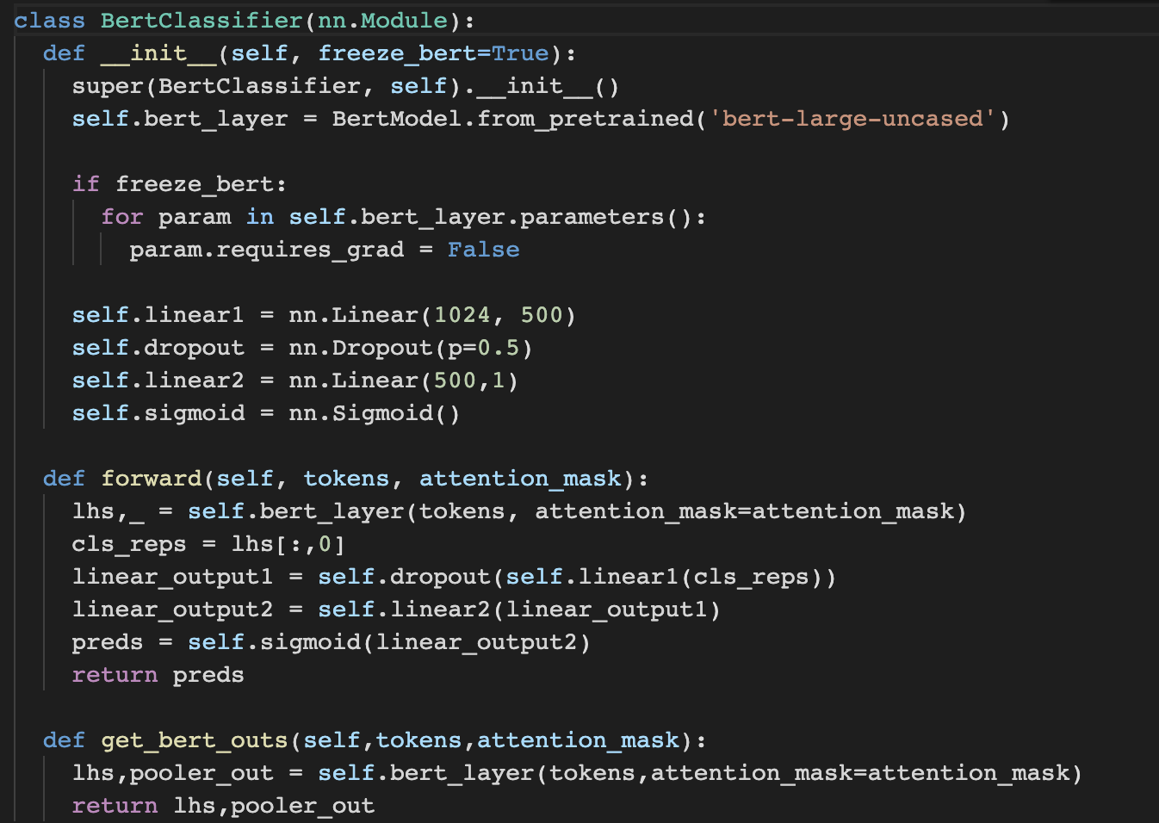
Our model - gammaBERT
1. Load pretrained BERT model
2. Fine-tune or Feature extract
3. Layers for sentiment classification
4. Forward pass function
Notes:
Test set consists of 10% of the dataset, 100 reviews.

Slide 8

BERT inputs
Last hidden states
Pooler output
Tokenize:
tokenizer.encode("Hi my name is Slim Shady")
Output: [101, 7632, 2026, 2171, 2003, 11754, 22824, 102]
BERT
Pad:
sentence = sentence + (32-len(sentence))*[tokenizer.pad_token_id]
Output: tensor([101,7632,1010,2026,2171,2003,11754,22824,102,0,
0,0,0,0,0,0,0,0,0,0,0,0,0,0,0,0,0,0,0,0,0,0])
Attention Mask
Tokens
Notes:
Test set consists of 10% of the dataset, 100 reviews.

Slide 9
BERT inputs
Last hidden states
Pooler output
Generate attention mask:
attn_mask = [1 if tokenid != tokenizer.pad_token_id else 0 for tokenid in sentence]
Output: [1,1, 1, 1, 1,1, 1, 1, 0, 0, 0, 0, 0, 0, 0, 0, 0, 0, 0,
0, 0, 0, 0, 0, 0, 0, 0, 0, 0, 0, 0, 0]
BERT
Attention Mask
Tokens
Notes:
Test set consists of 10% of the dataset, 100 reviews.

Slide 10
BERT outputs
Last hidden states
Pooler output
Last hidden state of CLS token processed by FC layer and Tanh activation
Used for next sentence prediction
NO USE TO US!
BERT
Attention Mask
Tokens
Notes:
Test set consists of 10% of the dataset, 100 reviews.

Slide 11
BERT outputs
Last hidden states
Pooler output
LHS: Tensor of size (batch size, sequence length, hidden
size)
IOW: Embeddings for each token in each sentence of batch
We want the embedding for CLS!
BERT
Attention Mask
Tokens
Notes:
Test set consists of 10% of the dataset, 100 reviews.

Slide 12
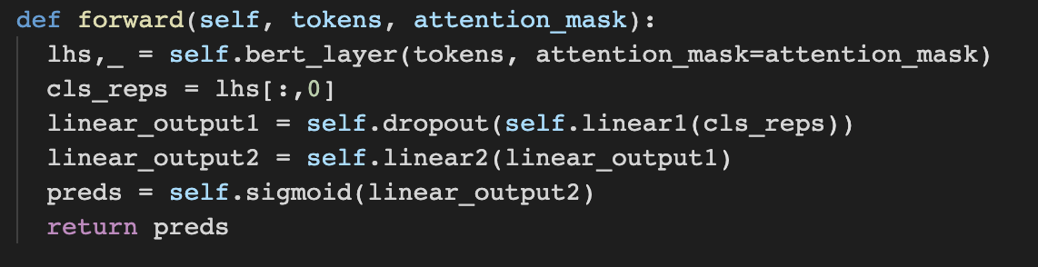
gammaBERT - Forward function
1. Pass tokens and attention mask to BERT
2. Get CLS representation
3. Pass through linear layers
4. Apply sigmoid and return
Notes:
Test set consists of 10% of the dataset, 100 reviews.

Slide 13
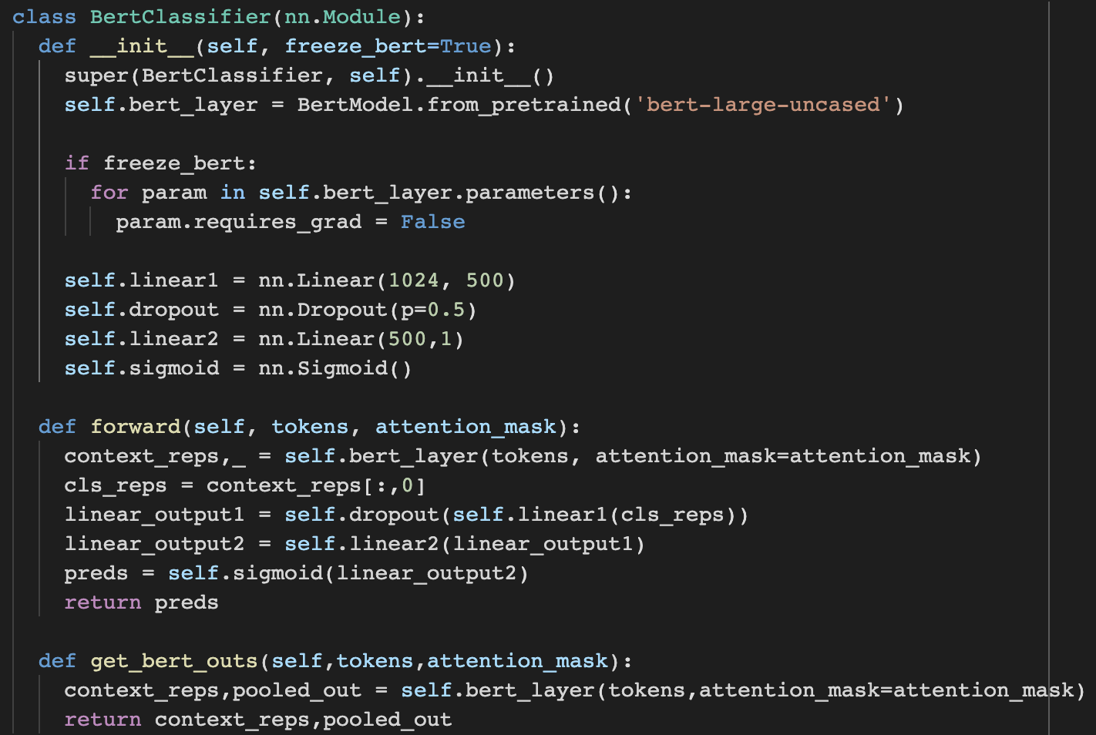
Our model - gammaBERT
Notes:
Test set consists of 10% of the dataset, 100 reviews.

Slide 14
Training Method
Hyper Parameters:
Loss function | BCEWithLogitsLoss
Optimizer | Adam
Initial Learning Rate | 1e-4 = 0.0001
Scheduler | ReduceLROnPlateau
Batch Size | 32
Patience | 6
Notes:
Hyper Parameters
Loss function Binary Cross Entropy Loss With Logits Loss
`Binary` 2 classes positive/negative sentiment
`Cross Entropy Loss` useful for classification
`With Logits Loss` precedes with a sigmoid function and also does log-sum-exp trick for numerical stability
Optimizer Adam
Default for training BERT
Generally useful to solve NLP tasks
Initial Learning Rate
Should be a small number, google used the same initial LR
Scheduler: Reduce Learning Rate On Plateau
Means in our case that learning rate should be lowered when the networks performs worse with some patience
Patience is 6
If the validation loss gets worse we run for 6 more epochs before doing early stopping
Checkpoints are stored whenever better validation loss is reached

Slide 15
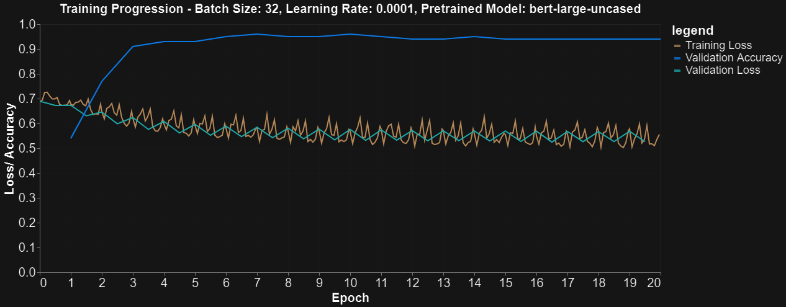
Training Results
Trained for 4m and 11s (20 epochs)
Running on Tesla K80 GPU
Highest Validation Accuracy - 96%
Average training loss: 0.542
Average validation loss: 0.551
Notes:
This is the training result running 4 minutes and 11 seconds (20 epochs) on a Tesla K80 GPU
From this graph we can see that the validation accuracy starts at about 50% and rises above 90% in 3 epochs.
It reaches the highest validation accuracy of 96% at epoch 10.
Note that loss values in the graph is the batch losses, at every other batch we plot the batch loss.
Then at each epoch we calculate the average loss, so these are the best average losses
...for training we get 0.542
...for validation we get 0.551

Slide 16
Test Results - Comparison
Test accuracy: 94%
Average test loss: 0.633
Average training loss: 0.542
Average validation loss: 0.551
Notes:
The test accuracy we got was 94% and the average loss is 0.663
Comparing the different losses we get similar values.
As mentioned previously the test set only consists of 10% of the dataset which is 100 reviews.

Slide 17
Live Demo

Slide 18
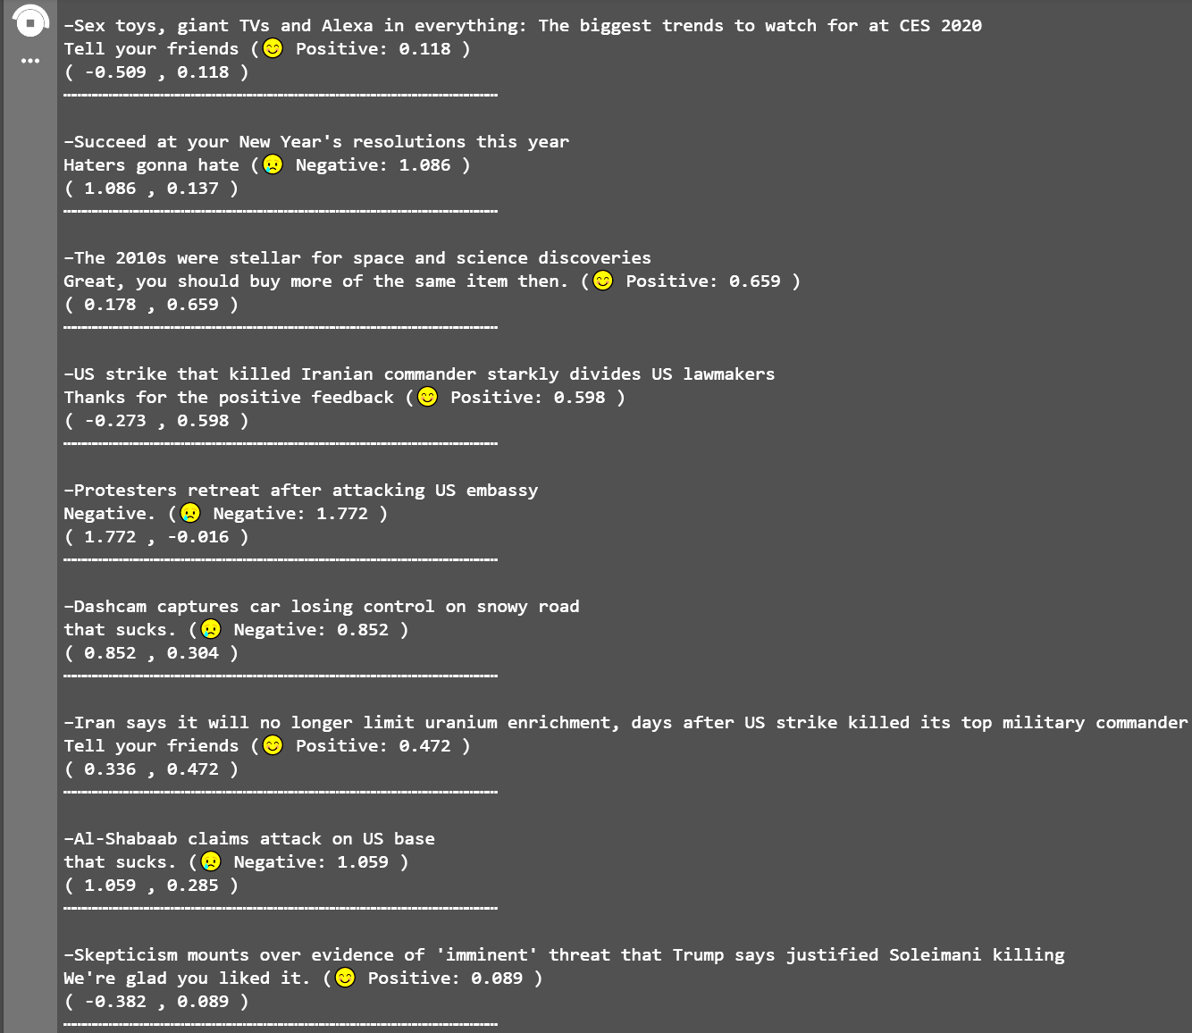
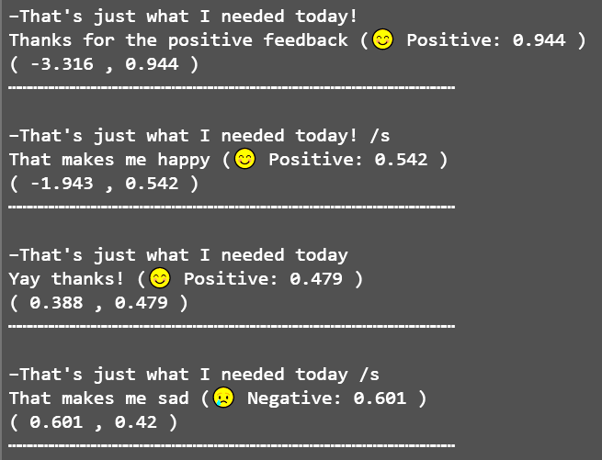
Albert Examples
Headlines from https://edition.cnn.com/
(5 Jan 2020)
Sarcasm?

Slide 19
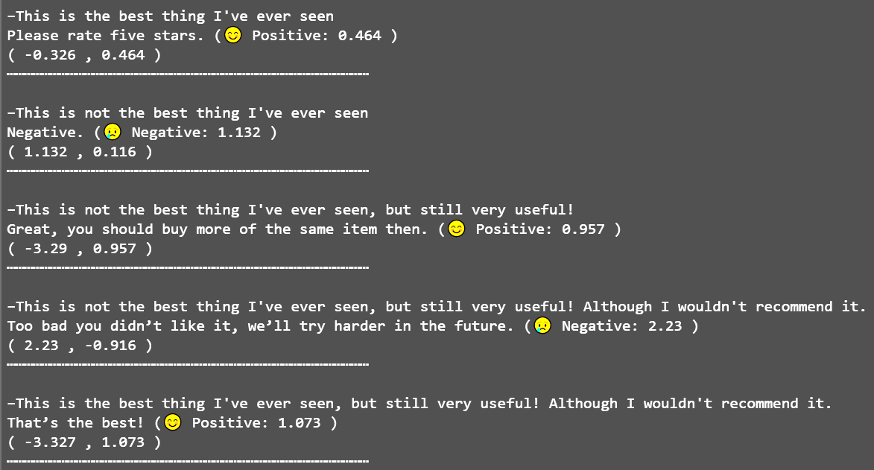
Albert Examples

Slide 20
Challenges / Improvements
Large model - RAM, compute
Only two classes - easy to accidentally guess right
Another network to give unique answers
One word reviews
More data for validation/test

Slide 21
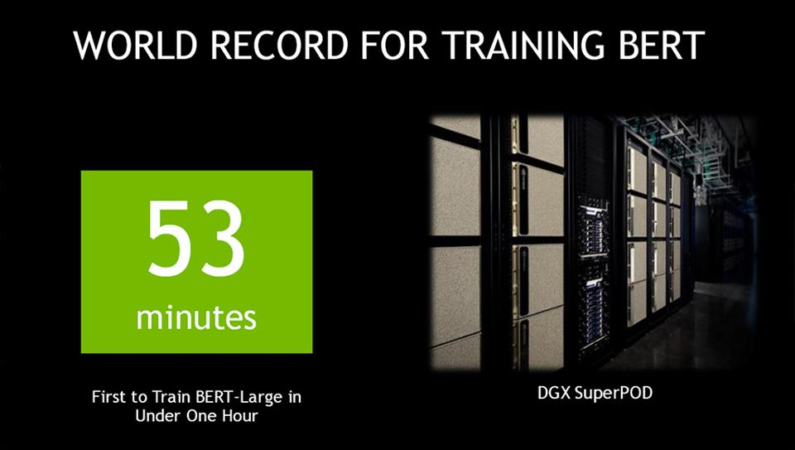
Final words on energy cost
Baseline Training
NVIDIA Tesla V100
TDP: 250W
1472×250 W (watts)×47 minutes = 1.04 Gigajoules
≈ 0.5 × Energy of an ordinary 61 liter gasoline tank ≈ 199 kilograms of carbon dioxide
≈ 1.21 Gigawatts for 0.859 seconds (Great Scott!)
Our Training
NVIDIA Tesla P100
TDP: 250W
250 W (watts)×12 minutes = 180 kJ (kilojoules)
≈ 1.2 × energy capacity of the iPad3 battery (≈ 43 Wh)
283 days 6 hours 44 minutes
To train from start
BERT-Large Training Times on NVIDIA DGX SuperPOD
Time: 47 min
Number of V100 GPUs: 1,472
https://devblogs.nvidia.com/training-bert-with-gpus/

